Slide 1

SHREE RAMSWAROOP MEMORIAL UNIVERSITY
Assignment:-9
Java Enterprise Edition Lab - 09
Submitted to:
Submitted by:
Vidushi Srivastava
Mukesh Prajapati
Btech (Cse Industry integrated)
Roll No – 202410101230007

Slide 2
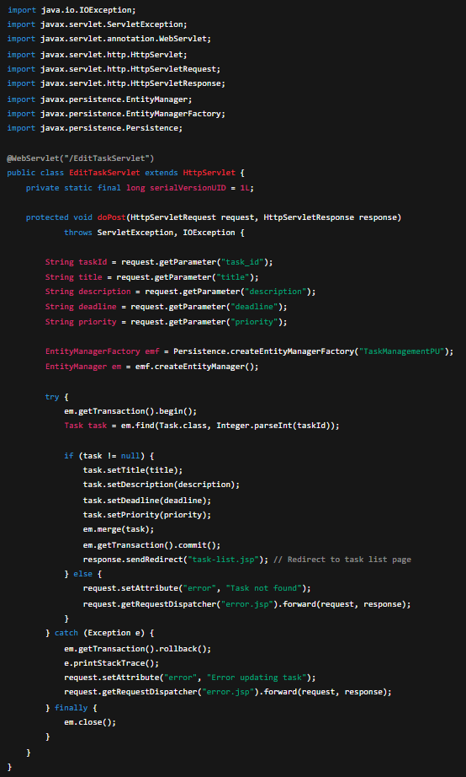
1⬛ Task Editing Form (edit-task.jsp)
This JSP displays the form pre-filled with the task’s current details, allowing users to modify and submit updates.

Slide 3
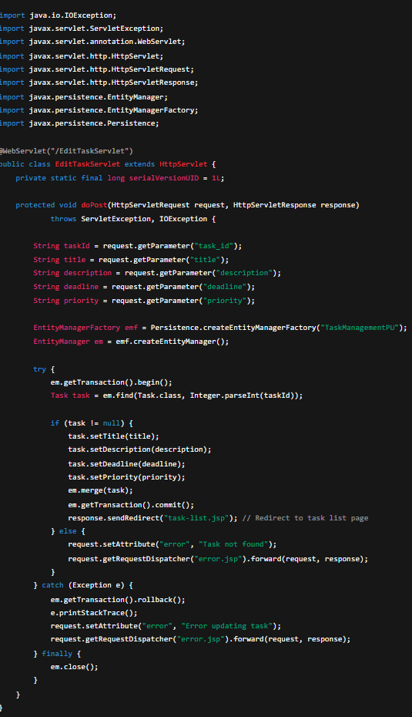
³⬛ Servlet: EditTaskServlet.java
Handles the update request and modifies the task record in the database.

Slide 4
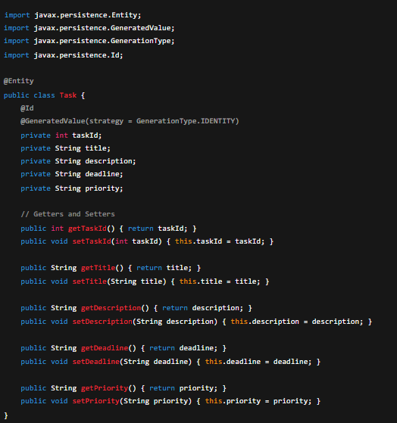
³⬛ JPA Entity: Task.java
Represents the task table and includes getter/setter methods.

Slide 5
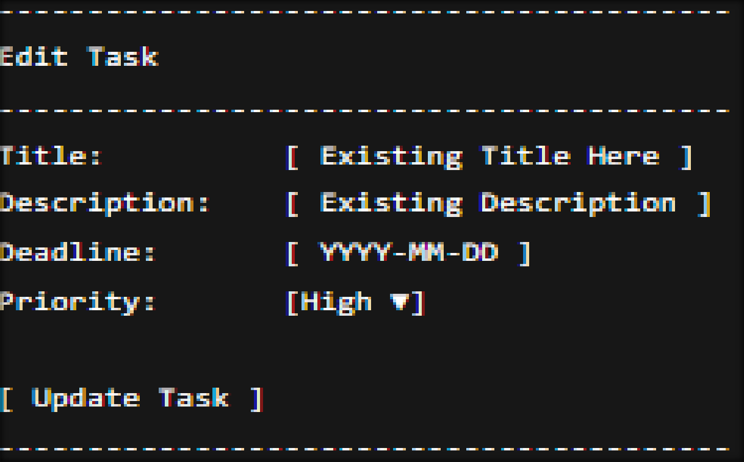
_;□ Example Output

